Slide 1
AZURE ADF

Slide 2
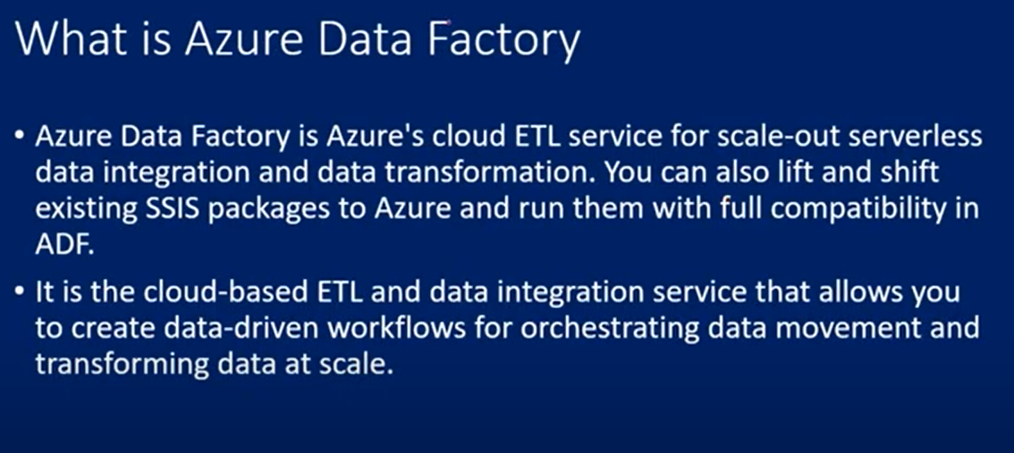
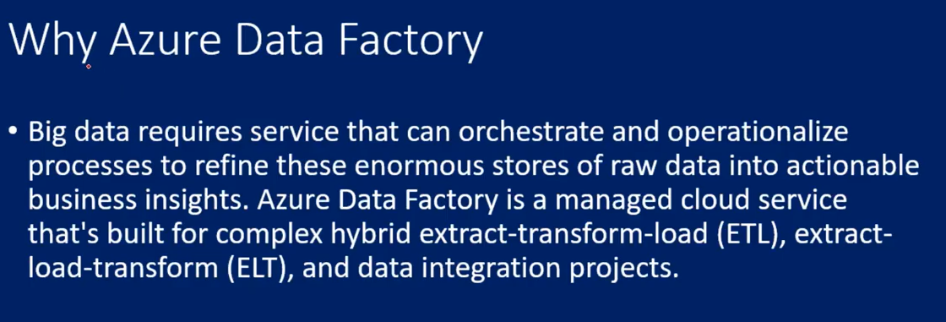

Slide 3
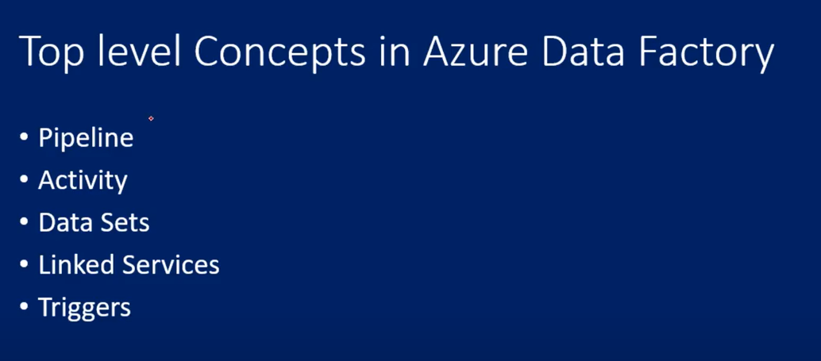
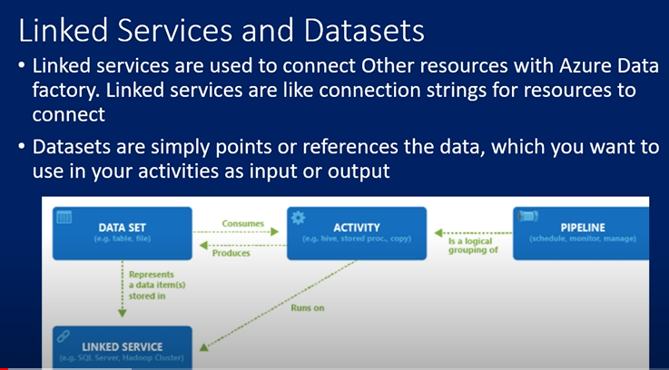

Slide 4
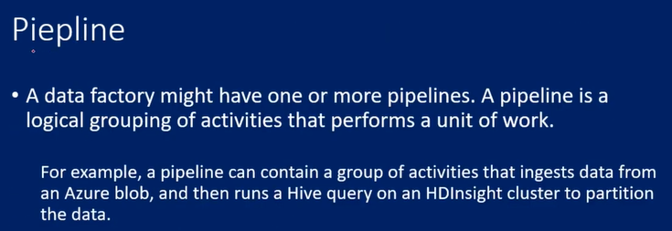
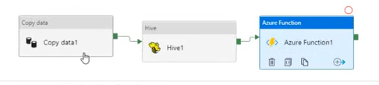
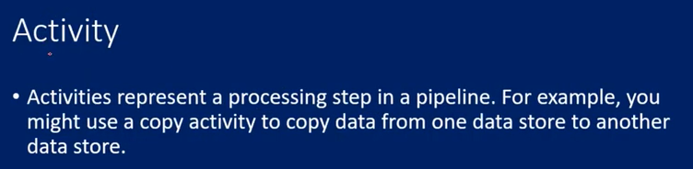
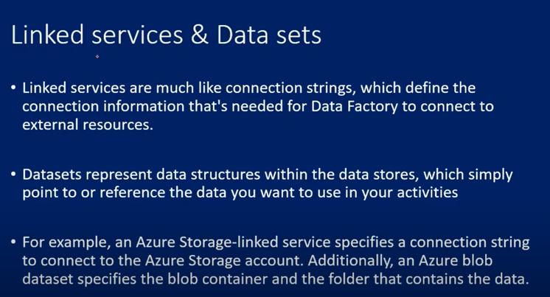
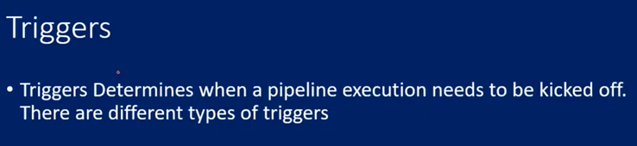

Slide 5
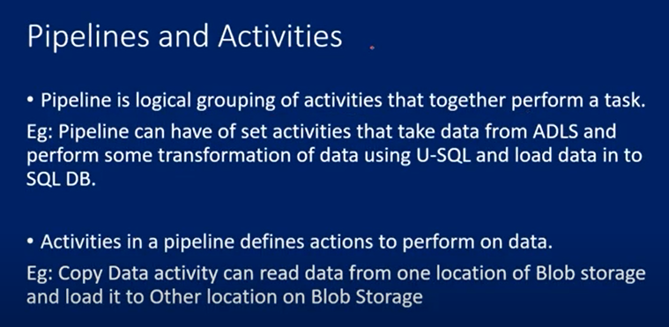
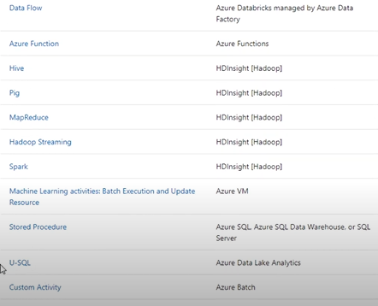
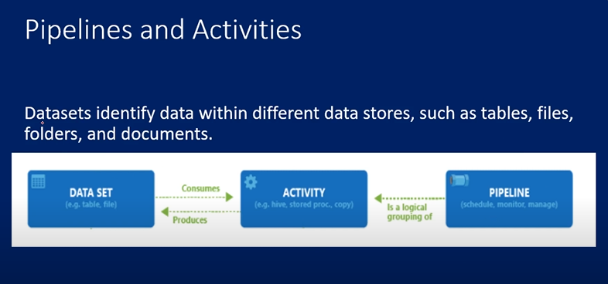

Slide 6
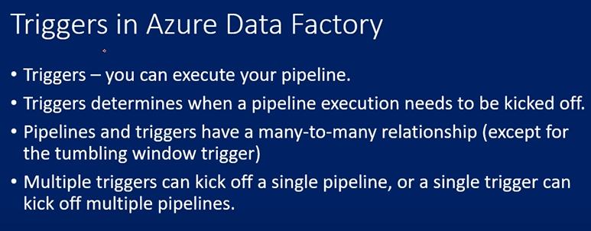
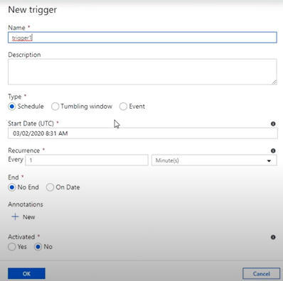
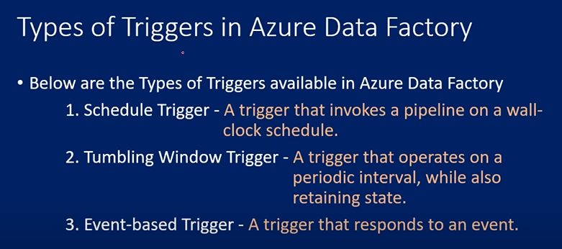

Slide 7
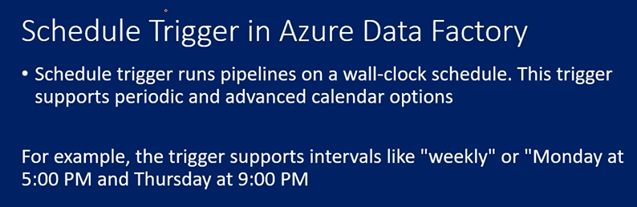
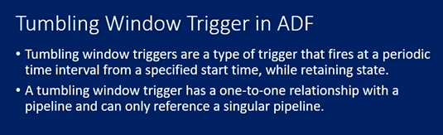
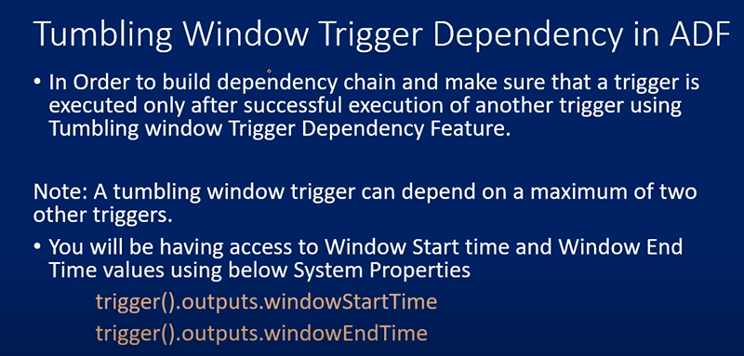
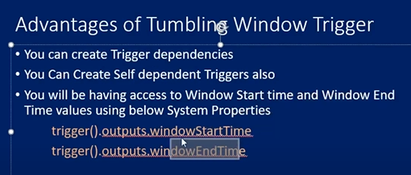

Slide 8
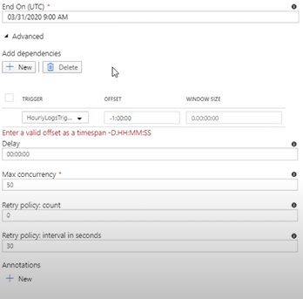
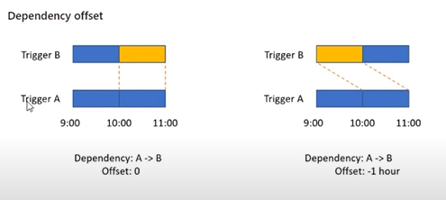

Slide 9
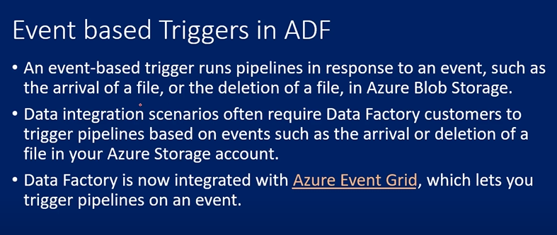
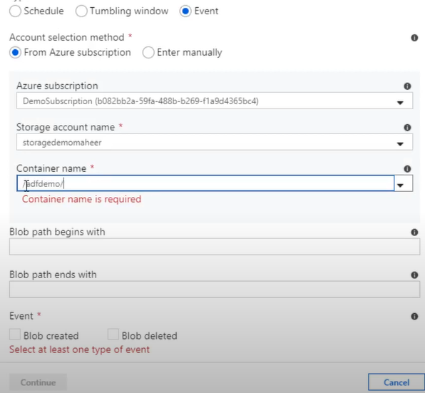
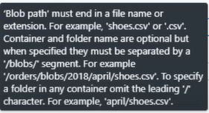
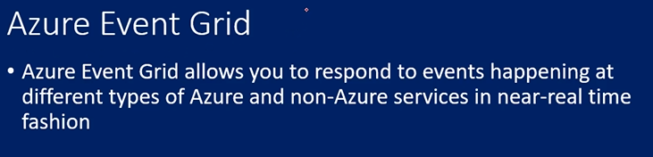

Here in pipeline level you can mention parameters and use those parameters in triggers to capture file name or folder path etc..

Slide 10
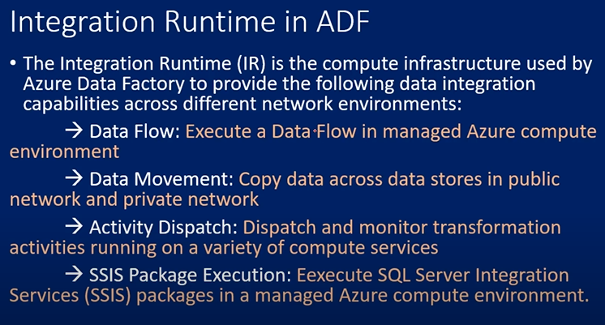
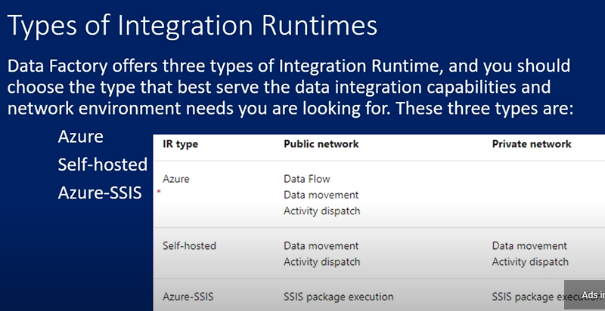
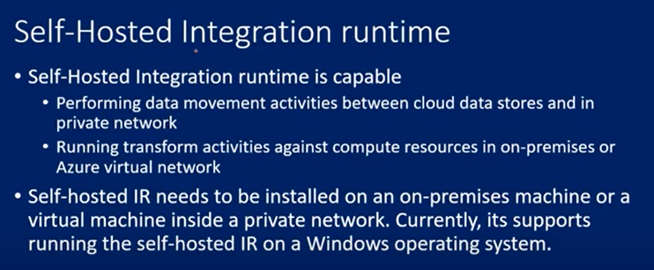

Slide 11
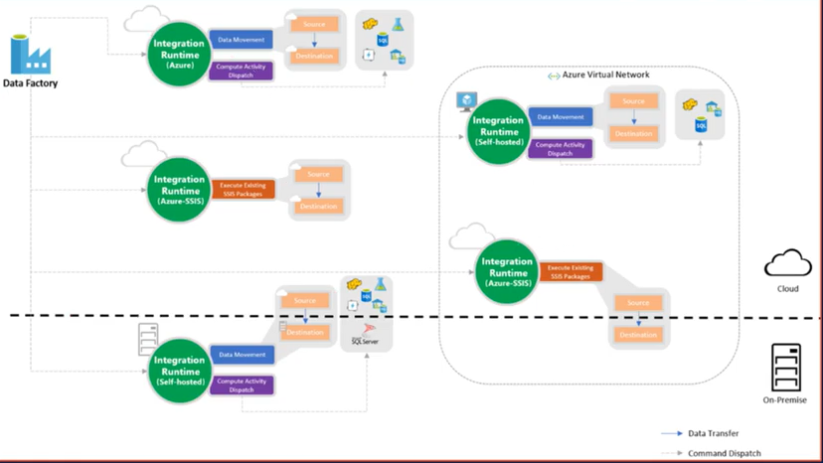

Slide 12
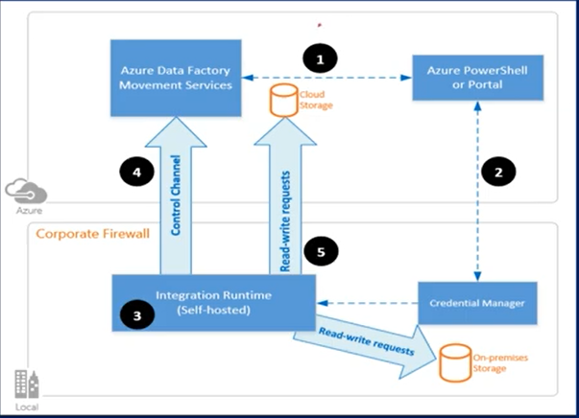
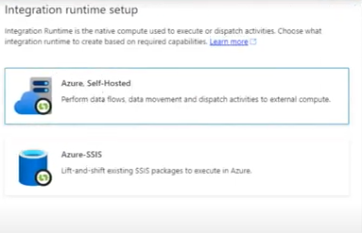
Setting up integration service is pretty simple go to integration runtimes and click new and selsct self hosted IR. Go with manual setup instead of express as it is more in our control
Download the self hosted software and install in client system and givge key to register

Slide 13
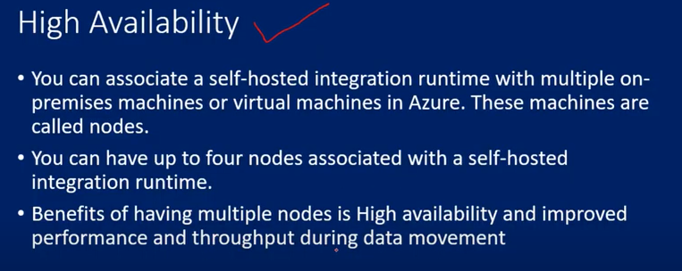
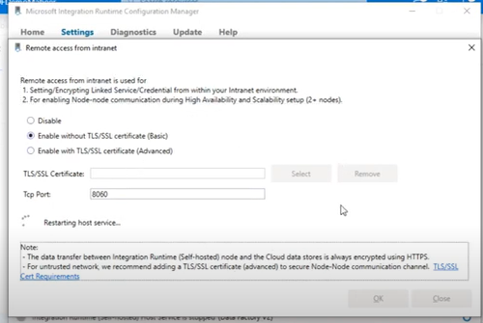
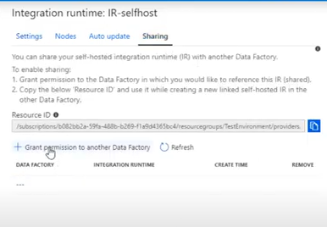
If u are maintain 1 node then if that node fails then it will be bottleneck so it is better to have multiple nodes for IR to configure the nodes we have to enable the remote access in configuration manager and add the nodes
Shared self hosted IR : In IR we have a sharing option there click on grant permission to another data factory

Slide 14
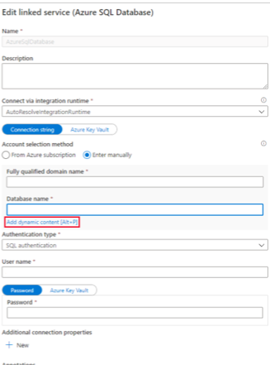
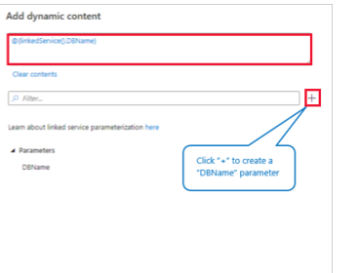
Parameterize linked services in Azure Data Factory
You can now parameterize a linked service and pass dynamic values at run time. For example, if you want to connect to different databases on the same logical SQL server, you can now parameterize the database name in the linked service definition. This prevents you from having to create a linked service for each database on the logical SQL server. You can parameterize other properties in the linked service definition as well - for example, User name.

Slide 15
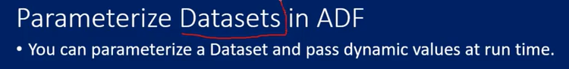
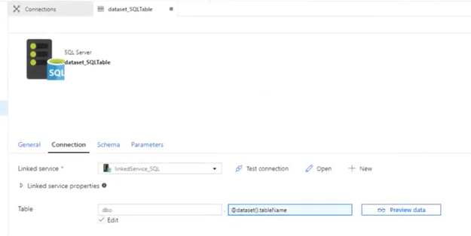
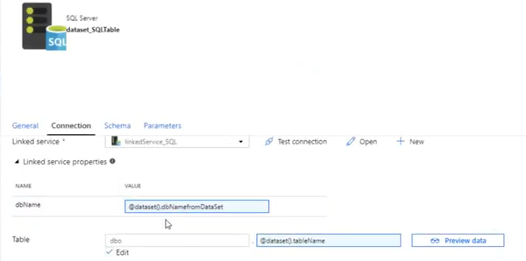
Created parameter called table name to pass the table name dynamically within the dataset scope and created another parameter called dbname at dataset level scope. So that I can pass the parameter at pipeline level that pass the dbname

Slide 16
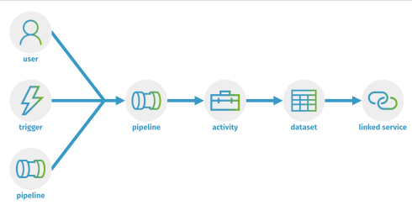
You can use parameters to pass external values into pipelines, datasets, linked services, and data flows. Once the parameter has been passed into the resource, it cannot be changed. By parameterizing resources, you can reuse them with different values each time.

Slide 17
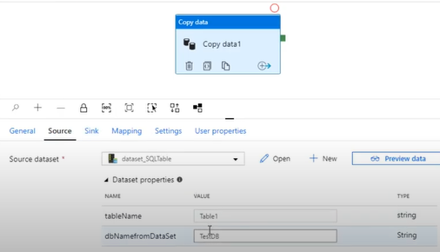
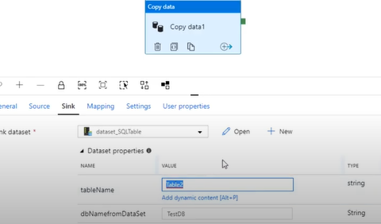
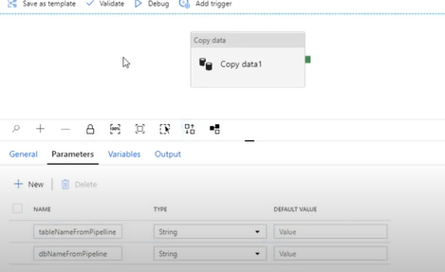
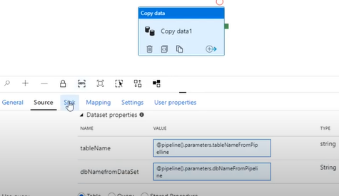

Slide 18
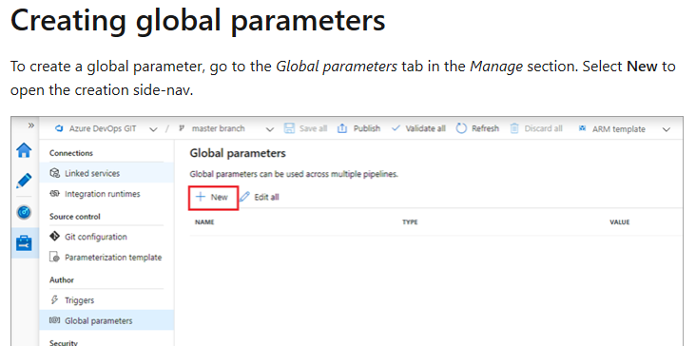
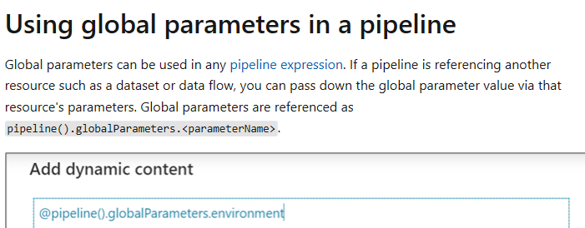
Global parameters in Azure Data Factory
Global parameters are constants across a data factory that can be consumed by a pipeline in any expression. They're useful when you have multiple pipelines with identical parameter names and values. When promoting a data factory using the continuous integration and deployment process (CI/CD), you can override these parameters in each environment.

Slide 19
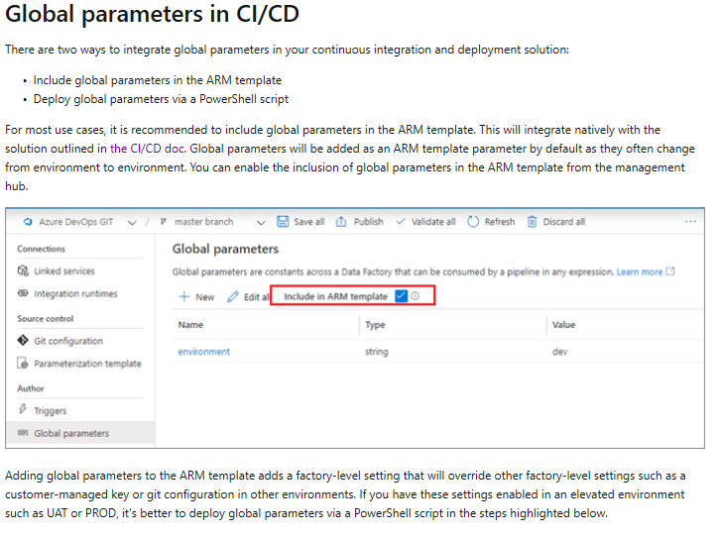

Slide 20
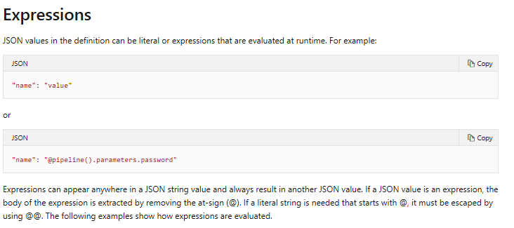
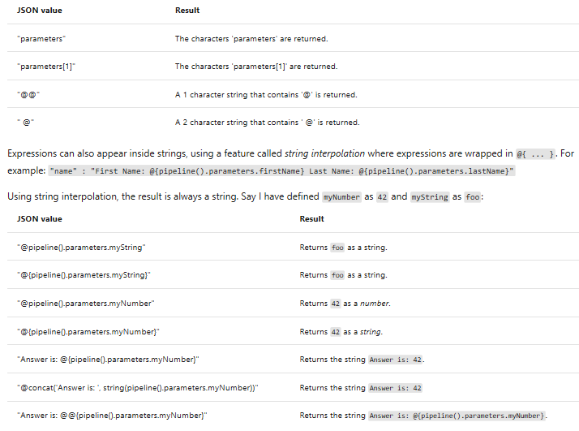
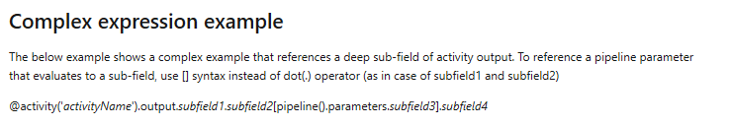
Expressions and functions in Azure Data Factory

Slide 21



System variables supported by Azure Data Factory
This article describes system variables supported by Azure Data Factory. You can use these variables in expressions when defining Data Factory entities.

Slide 22



Here we have used pipeline predefined parameters to get runtime id and datafactory name

Slide 23


Parameterizing mapping data flows

Slide 24



Slide 25



Some of the datastore is listed here and most of the connectors support copy activity but not data flow

Slide 26




Slide 27



Slide 28









Slide 29
















Slide 30










Slide 31


Slide 32





Slide 33




Here we are creating a file type variable that replaces the Sales string to empty and loading hourly and daily data

Slide 34
Parameters are something that can be set to model (dataset, pipeline, etc) at runtime. Without parameters, you model is fixed, for example, without parameters you can only write query like "select * from order where timestamp > '11/01/2018'" in dataset, with parameter 'TS' you can write query like "select * from order where timestamp > '@dataset.TS'" so that your activity run will query and copy data in different time window.
Variables are something that contain real value at runtime and can be assigned to those parameters in app model(dataset, pipeline, etc) to get real things done.
In the above example variables are used to dynamically pass the file name and if condition to load data to the respective hourly,daily tables

Slide 35


Use the Set Variable activity to set the value of an existing variable of type String, Bool, or Array defined in a Data Factory pipeline.
You can set a value of a variable that is defined during your pipeline execution

Slide 36





Slide 37


Child pipeline

Slide 38



Slide 39


The ForEach Activity defines a repeating control flow in your pipeline. This activity is used to iterate over a collection and executes specified activities in a loop. The loop implementation of this activity is similar to Foreach looping structure in programming languages.
The items property is the collection and each item in the collection is referred to by using the @item()
isSequential: Specifies whether the loop should be executed sequentially or in parallel. Maximum of 20 loop iterations can be executed at once in parallel). For example, if you have a ForEach activity iterating over a copy activity with 10 different source and sink datasets with isSequential set to False, all copies are executed at once. Default is False. If "isSequential" is set to False, ensure that there is a correct configuration to run multiple executables. Otherwise, this property should be used with caution to avoid incurring write conflicts. For more information, see Parallel execution section.
batchCount: Batch count to be used for controlling the number of parallel execution (when isSequential is set to false). This is the upper concurrency limit, but the for-each activity will not always execute at this number
Items: An expression that returns a JSON Array to be iterated over.

Slide 40

You can use the Get Metadata activity to retrieve the metadata of any data in Azure Data Factory. You can use the output from the Get Metadata activity in conditional expressions to perform validation, or consume the metadata in subsequent activities. The Get Metadata activity takes a dataset as an input and returns metadata information as output.

Slide 41


Slide 42



Slide 43


If Condition activity in Azure Data Factory

Slide 44


Lookup Activity

Slide 45






Slide 46



Slide 47


Slide 48



Slide 49

Copy multiple tables in Bulk with Lookup & ForEach

Slide 50



Slide 51


SWITCH Activity

Slide 52


Until activity in Azure Data Factory
It executes a set of activities in a loop until the condition associated with the activity evaluates to true. You can specify a timeout value for the until activity in Data Factory.

Slide 53


Validation activity in Azure Data Factory
You can use a Validation in a pipeline to ensure the pipeline only continues execution once it has validated the attached dataset reference exists, that it meets the specified criteria, or timeout has been reached

Slide 54

Execute wait activity in Azure Data Factory
When you use a Wait activity in a pipeline, the pipeline waits for the specified period of time before continuing with execution of subsequent activities.

Slide 55

Web activity in Azure Data Factory
Web Activity can be used to call a custom REST endpoint from a Data Factory pipeline. You can pass datasets and linked services to be consumed and accessed by the activity.
When you use the POST/PUT method, the body property represents the payload that is sent to the endpoint. You can pass linked services and datasets as part of the payload. Here is the schema for the payload:

Slide 56





Slide 57


Webhook activity in Azure Data Factory

Slide 58



Slide 59


Slide 60



Slide 61


Slide 62


Slide 63


Slide 64

DATA FLOW
Source and sink transformation in mapping data flow
Allow schema drift: Select Allows schema drift if the source columns will change often this setting will allow nall the incoming fields from your source to flow through the transformations at the sink
Infer drifted column type: Allows auto detection of drifted column types
Validate scema: Setting this option will cause data flow to fail if any column and type defined in the projection tab does not mantch the incoming data

Slide 65





Partition root path: for file data that is portioned you can enter a partition root path in order to read portioned folders as columns
We can add dynamic content to all the options (to automate)

Slide 66







Slide 67



Parameterize mapping data flow
Sink as file in data factory

Slide 68




Slide 69


The Aggregate transformation defines aggregations of columns in your data streams. Using the Expression Builder, you can define different types of aggregations such as SUM, MIN, MAX, and COUNT grouped by existing or computed columns.
A group by clause is optional in an Aggregate transformation.

Slide 70




Slide 71




Use the expression builder to enter the match condition. Create a boolean expression that matches columns based on the name, type, stream, origin, and position of the column. The pattern will affect any column, drifted or defined, where the condition returns true.
The two expression boxes below the match condition specify the new names and values of the affected columns. Use $$ to reference the existing value of the matched field. The left expression box defines the name and the right expression box defines the value.

Slide 72



Slide 73




Slide 74

Use the Alter Row transformation to set insert, delete, update, and upsert policies on rows. You can add one-to-many conditions as expressions. These conditions should be specified in order of priority, as each row will be marked with the policy corresponding to the first-matching expression. Each of those conditions can result in a row (or rows) being inserted, updated, deleted, or upserted. Alter Row can produce both DDL & DML actions against your database.
Alter Row transformations will only operate on database or CosmosDB sinks in your data flow. The actions that you assign to rows (insert, update, delete, upsert) won't occur during debug sessions. Run an Execute Data Flow activity in a pipeline to enact the alter row policies on your database tables.

Slide 75


If your inserts, updates, or upserts modify the schema of the target table in the sink, the data flow will fail. To modify the target schema in your database, choose Recreate table as the table action. This will drop and recreate your table with the new schema definition.

Slide 76


Slide 77

Merges and upserts with Azure SQL Database and Synapse

Slide 78


Conditional split transformation in mapping data flow
The conditional split transformation routes data rows to different streams based on matching conditions. The conditional split transformation is similar to a CASE decision structure in a programming language. The transformation evaluates expressions, and based on the results, directs the data row to the specified stream.

Slide 79


Use the derived column transformation to generate new columns in your data flow or to modify existing fields.
When creating a derived column, you can either generate a new column or update an existing one. In the Column textbox, enter in the column you are creating. To override an existing column in your schema, you can use the column dropdown

Slide 80


Slide 81



To create a free-form expression that contains operators other than "and" and "equals to", select the Custom expression field. Enter a custom expression via the data flow expression builder by clicking on the blue box.

Slide 82


Slide 83

The Filter transforms allows row filtering based upon a condition. The output stream includes all rows that matching the filtering condition. The filter transformation is similar to a WHERE clause in SQL

Slide 84


Unroll by
Select an array to unroll. The output data will have one row per item in each array. If the unroll by array in the input row is null or empty, there will be one output row with unrolled values as null.
Unroll root
By default, the flatten transformation unrolls an array to the top of the hierarchy it exists in. You can optionally select an array as your unroll root. The unroll root must be an array of complex objects that either is or contains the unroll by array. If an unroll root is selected, the output data will contain at least one row per items in the unroll root. If the input row doesn't have any items in the unroll root, it will be dropped from the output data. Choosing an unroll root will always output a less than or equal number of rows than the default behavior.

Slide 85




Use the join transformation to combine data from two sources or streams in a mapping data flow. The output stream will include all columns from both sources matched based on a join condition

Slide 86



Slide 87



Lookup transformation in mapping data flow
Cached lookup
If you're doing multiple smaller lookups on the same source, a cached sink and lookup maybe a better use case than the lookup transformation. Common examples where a cache sink may be better are looking up a max value on a data store and matching error codes to an error message database. For more information, learn about cache sinks and cached lookups.

Slide 88
Primary stream: The incoming stream of data. This stream is equivalent to the left side of a join.
Lookup stream: The data that is appended to the primary stream. Which data is added is determined by the lookup conditions. This stream is equivalent to the right side of a join.
Match multiple rows: If enabled, a row with multiple matches in the primary stream will return multiple rows. Otherwise, only a single row will be returned based upon the 'Match on' condition.
Match on: Only visible if 'Match multiple rows' is not selected. Choose whether to match on any row, the first match, or the last match. Any row is recommended as it executes the fastest. If first row or last row is selected, you'll be required to specify sort conditions.
Lookup conditions: Choose which columns to match on. If the equality condition is met, then the rows will be considered a match. Hover and select 'Computed column' to extract a value using the data flow expression language.
The lookup transformation only supports equality matches. To customize the lookup expression to include other operators such as greater than, it's recommended to use a cross join in the join transformation. A cross join will avoid any possible cartesian product errors on execution.
All columns from both streams are included in the output data. To drop duplicate or unwanted columns, add a select transformation after your lookup transformation. Columns can also be dropped or renamed in a sink transformation.

Slide 89

A cache sink is when a data flow writes data into the Spark cache instead of a data store. In mapping data flows, you can reference this data within the same flow many times using a cache lookup. This is useful when you want to reference data as part of an expression but don't want to explicitly join the columns to it. Common examples where a cache sink can help are looking up a max value on a data store and matching error codes to an error message database.
To write to a cache sink, add a sink transformation and select Cache as the sink type. Unlike other sink types, you don't need to select a dataset or linked service because you aren't writing to an external store.

Slide 90


Slide 91
Cached lookup
A cached lookup allows you to do an inline lookup of the output of a cached sink. There are two functions available to use on each sink, lookup() and outputs(). The syntax to reference these functions is cacheSinkName#functionName(). For more information, see cache sinks.
lookup() takes in the matching columns in the current transformation as parameters and returns a complex column equal to the row matching the key columns in the cache sink. The complex column returned contains a subcolumn for each column mapped in the cache sink. For example, if you had an error code cache sink errorCodeCache that had a key column matching on the code and a column called Message. Calling errorCodeCache#lookup(errorCode).Message would return the message corresponding with the code passed in.
outputs() takes no parameters and returns the entire cache sink as an array of complex columns. This can't be called if key columns are specified in the sink and should only be used if there is a small number of rows in the cache sink. A common use case is appending the max value of an incrementing key. If a cached single aggregated row CacheMaxKey contains a column MaxKey, you can reference the first value by calling CacheMaxKey#outputs()[1].MaxKey.

Slide 92


Slide 93

Add a new branch to do multiple sets of operations and transformations against the same data stream. Adding a new branch is useful when you want to use the same source to for multiple sinks or for self-joining data together.
A new branch can be added from the transformation list similar to other transformations. New Branch will only be available as an action when there's an existing transformation following the transformation you're attempting to branch.

Slide 94


Use the Parse transformation to parse columns in your data that are in document form. The current supported types of embedded documents that can be parsed are JSON and delimited text.

Slide 95

Use the pivot transformation to create multiple columns from the unique row values of a single column. Pivot is an aggregation transformation where you select group by columns and generate pivot columns using aggregate functions. The pivot transformation requires three different inputs: group by columns, the pivot key, and how to generate the pivoted columns
Select which columns to aggregate the pivoted columns over. The output data will group all rows with the same group by values into one row. The aggregation done in the pivoted column will occur over each group.
This section is optional. If no group by columns are selected, the entire data stream will be aggregated and only one row will be outputted.

Slide 96


The pivot key is the column whose row values get pivoted into new columns. By default, the pivot transformation will create a new column for each unique row value.
In the section labeled Value, you can enter specific row values to be pivoted. Only the row values entered in this section will be pivoted. Enabling Null value will create a pivoted column for the null values in the column.

Slide 97

For each unique pivot key value that becomes a column, generate an aggregated row value for each group. You can create multiple columns per pivot key. Each pivot column must contain at least one aggregate function.
Column name pattern: Select how to format the column name of each pivot column. The outputted column name will be a combination of the pivot key value, column prefix and optional prefix, suffice, middle characters.
Column arrangement: If you generate more than one pivot column per pivot key, choose how you want the columns to be ordered.
Column prefix: If you generate more than one pivot column per pivot key, enter a column prefix for each column. This setting is optional if you only have one pivoted column.
If no values are specified in the pivot key configuration, the pivoted columns will be dynamically generated at run time. The number of pivoted columns will equal the number of unique pivot key values multiplied by the number of pivot columns. As this can be a changing number, the UX will not display the column metadata in the Inspect tab and there will be no column propagation. To transformation these columns, use the column pattern capabilities of mapping data flow.
If specific pivot key values are set, the pivoted columns will appear in the metadata. The column names will be available to you in the Inspect and Sink mapping.

Slide 98


Slide 99


Unpivot transformation in mapping data flow
Use Unpivot in ADF mapping data flow as a way to turn an unnormalized dataset into a more normalized version by expanding values from multiple columns in a single record into multiple records with the same values in a single column.

Slide 100



Slide 101


Use the rank transformation to generate an ordered ranking based upon sort conditions specified by the user.

Slide 102




Use the select transformation to rename, drop, or reorder columns. This transformation doesn't alter row data, but chooses which columns are propagated downstream.

Slide 103



Rule-based mapping

Slide 104


Slide 105


Slide 106




Slide 107



Slide 108





Slide 109

The sort transformation allows you to sort the incoming rows on the current data stream. You can choose individual columns and sort them in ascending or descending order

Slide 110



Use the surrogate key transformation to add an incrementing key value to each row of data. This is useful when designing dimension tables in a star schema analytical data model. In a star schema, each member in your dimension tables requires a unique key that is a non-business key.

Slide 111



Slide 112


Union will combine multiple data streams into one, with the SQL Union of those streams as the new output from the Union transformation. All of the schema from each input stream will be combined inside of your data flow, without needing to have a join key.
You can combine n-number of streams in the settings table by selecting the "+" icon next to each configured row, including both source data as well as streams from existing transformations in your data flow.

Slide 113


The Window transformation is where you will define window-based aggregations of columns in your data streams. In the Expression Builder, you can define different types of aggregations that are based on data or time windows (SQL OVER clause) such as LEAD, LAG, NTILE, CUMEDIST, RANK, etc.). A new field will be generated in your output that includes these aggregations. You can also include optional group-by fields.

Slide 114



Slide 115


Use the surrogate key transformation to add an incrementing key value to each row of data. This is useful when designing dimension tables in a star schema analytical data model. In a star schema, each member in your dimension tables requires a unique key that is a non-business key.
Increment keys from existing sources
To start your sequence from a value that exists in a source, we recommend to use a cache sink to save that value and use a derived column transformation to add the two values together. Use a cached lookup to get the output and append it to the generated key. For more information, learn about cache sinks and cached lookups.

Slide 116


Slide 117


Slide 118



Slide 119


Slide 120



Slide 121

How we are going to prompt this pipelines to test and uat?

Slide 122


Slide 123


